Slide 1
Course Overview
OS goals
CPU management
Memory management
Filesystem management
Processes (L2)
Scheduling (L3)
Memory organization (L8)
Virtual memory (L9-10)
Filesystems (L11)
Synchronization (L4-5)
Deadlocks (L6)
I/O & disk (L12)
Special: Real-time OS & virtualization (L7)

Slide 2

Concepts & Questions

Slide 3
Concepts & Questions

Slide 4
Concepts & Questions

Slide 5
Part 6: Real-Time OS & Virtualization
What is a Real-Time OS (RTOS)?
Real-Time Process Specification
Real-Time CPU Scheduling
Virtualization
Notes:
In this part, we take a closer look at Real-Time Operating Systems (RTOS). We understand the applications and their requirements for which a RTOS is appropriate. We then look at some of the key features and functions of a RTOS, over and above the services in a standard OS.
We then look at some examples of CPU scheduling algorithms that are specific to RTOS and provide the appropriate functions essential to meet application requirements.
Finally, we take a look at some of the techniques for hardware virtualization, understand what virtualization means, as well as list some popular examples.

Slide 6
Cyber-Physical Systems
Physical/Engineered systems whose operations are monitored, coordinated and controlled by a reliable computing and communication core
Automotive Systems (Autonomous driving, Parking assist, Airbag controls)
Avionics (Flight navigation & control)
Manufacturing Systems (Robotics, Process controls)
Medical Systems (Robotic surgery, devices)
…
Notes:
Trend 1: Proliferation of sensor devices. As these devices include embedded processors that are increasingly becoming smaller and also more powerful and plentiful; that is, they are everywhere and can support complex functionalities. They range from simple environmental monitoring, to medical devices, to cargo ships, to factories, to smart spaces that are for assisted living for elderly or disabled.
Trend 2: The second trend is that these systems are increasingly being integrated as system of systems. These integrations can range from simple interconnection to exchange sensor data, to inter-operations to support remote command and control, to total integration to serve as a coherent, large-scale complex system.

Slide 7
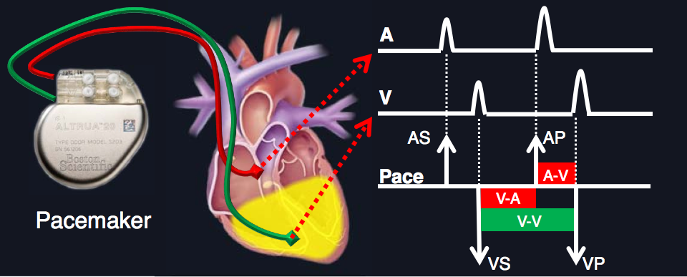
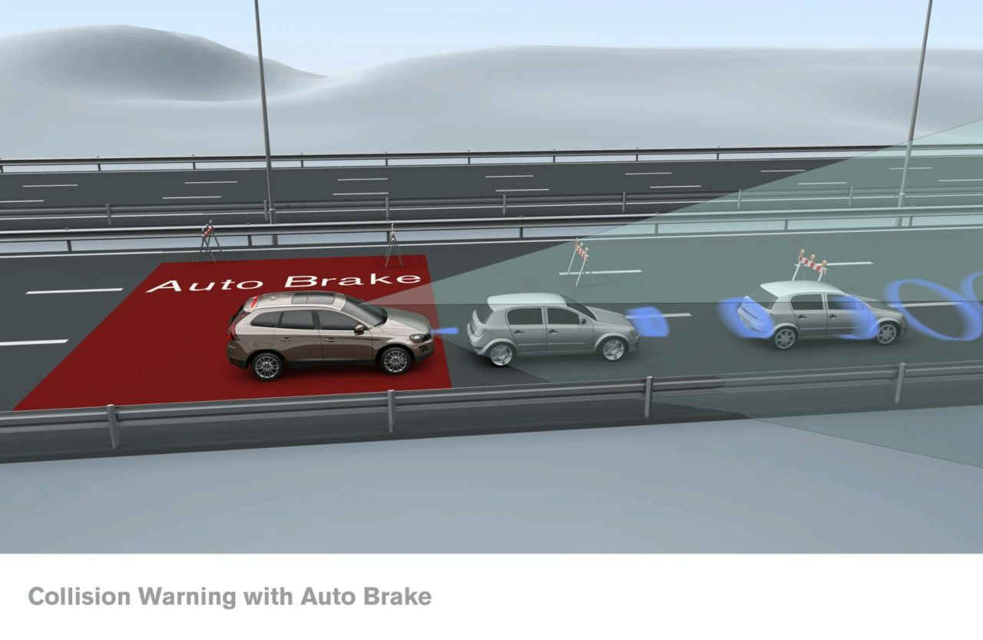
Relevance of Real-Time
Common to many application examples we saw in the previous slide:
Collect data from various sensing devices
Execute control law(s) to determine response
Send actuator commands in a reasonable amount of time
Pacemaker timing diagram
Collision avoidance and braking
Notes:
Common requirements among several of the CPS applications is that of real-time. Meaning the applications are required to process inputs and generate outputs within a pre-defined amount of time. We can call this time the application deadline. Not only does the application have to produce a functionally correct output, but it must do so within this deadline. So, for such applications, both functional/logical correctness as well as temporal correctness or timeliness are equally important.
Couple of examples of such real-time CPS applications are given here. One is that of a pace-maker, which is a medical device embedded in a human body. It monitors the electrical pulses generated by the brain to stimulate the heart muscles. Whenever the electrical pulses do not arrive in time from the brain, the pace-maker provides a replacement pulse to stimulate the appropriate chamber of the heart. This is a very critical device with some extremely precise real-time requirements, usually in the high milliseconds range.
Another example is that of a collision detection and avoidance system in autonomous driving. Sensors, usually cameras and lidars, provide information about the environment. This data must be perceived and a decision taken to control the speed of the ego vehicle depending on whether its path is clear or has other objects which can lead to potential collisions. Again a very critical system with real-time requirements, and depending on the speed of the vehicles involved, the real-time requirements can be below 100 milliseconds.

Slide 8
What is a Reasonable Time?
What is the functionality?
Collision avoidance in automotive (milliseconds)
Pacemaker (up to a second)
Robotic surgery (varies greatly depending on the target)
What are the environment constraints?
Available computing and communication resources
Timing characteristics of sensors/actuators/operations
Failure-mitigation strategies?
Time to detect and recover from failures
Example: execution replication for redundancy
Notes:
Although several CPS applications have hard real-time requirements (deadlines), the notion of these requirements are dependent on various factors.
It depends on the type of functionality. The notion of real-time could range from a few milliseconds to potentially even few minutes. Longer time durations would usually then not be considered as real-time requirements, but instead would be regarded as design-time planning.
It also depends on the constraints imposed by the surrounding environment, such as available computing and communication resources, the timing characteristics of the mechanical devices and processes, etc.
Finally, it can also depend on some design considerations such as techniques for failure mitigation. This may need to consider the timing overhead of strategies for detecting and recovering from failures. An example could replication of computation for redundancy.

Slide 9

Common Misconception
Real-Time ≠ Fast
Real-Time = Predictable even in the worst-case
“Man drowned in a river with average depth 20 cms”
Notes:
A common misconception is that real-time requirements imply fast execution on an average or simply fast response times. This is not true at all.
Real-time requirements imply guarantees on the worst-case response times, AND NOT average case response times. So, in the worst-case, the execution of the application must be completed within the pre-specified deadline.

Slide 10
Check Your Understanding

Slide 11
Real-Time CPS / Real-Time OS
Definition: System whose correctness depends not only on the logical/functional aspects, but also on the temporal aspects
Application has deadlines that must be met
A real-time OS (RTOS) provides OS services to such systems (e.g., FreeRTOS, MicriumOS, …)
Key performance measure for RTOS
Timeliness/Predictability on timing constraints (deadlines)
Significance of worst-case over average-case
Deadlines are a function of application requirements
Notes:
In summary, the key focus of real-time CPS, and hence real-time OS, is that of ensuring predictability over the timing constraints. In the worst-case, the timing requirements of the application must be met. This worst-case must take into account the impact from mechanical devices, computation (both software and hardware), communication, etc.

Slide 12
Check Your Understanding

Slide 13
Part 5: Real-Time OS & Virtualization
What is a Real-Time OS (RTOS)?
Real-Time Process Specification
Real-Time CPU Scheduling
Virtualization

Slide 14
RTOS (Real-Time) Process
Definition: A real-time process is specified as <R,C,D>, where R is process release time, C is execution requirement and D is relative deadline
Requires C time units of CPU in the interval [R, R+D)
How does one determine these parameters?
Example: P₁<0,5,10>, P₂<5,10,35>, P₃<20,10,30>
In this lecture, we assume processes only have a single CPU burst; C is the duration of this burst
P₁
release
P₂
release
P₁
deadline
P₃
release
P₂
deadline
P₃
deadline
0 5 10 15 20 25 30 35 40 45 50
Notes:
We now consider how to model a real-time RTOS process. We need to know when the process is released for execution in the system. We need to know how much CPU cycles it needs in the worst-case. We also need to know by when it requires these CPU cycles. Only with these parameters can the RTOS manage the processes to ensure that their real-time requirements (deadlines) can be met.
It is an interesting question to understand how one could determine these process parameters. R and D are straightforward. Usually they are derived depending on the application requirements. How often or when the application needs to run and by when should it complete. However, C is challenging to determine. It is the worst-case execution requirement, meaning the maximum CPU cycles that the process will ever require. This is usually very hard to determine.
In this lecture, to keep things simple, we ignore I/O bursts and assume that all processes only have a single CPU burst.

Slide 15
Recurrent Real-Time Process
Nature of real-time processes
Collect data from sensing devices, execute control laws to determine responses, and send actuator commands in reasonable time
Repeat the above steps regularly
Examples: airbag control, flight control, collision avoidance, pacemaker, etc.
A recurrent real-time process
Executes some function repeatedly over time
Each instance of execution is a real-time process <R,C,D>
Notes:
In many real-time applications, the nature of a real-time process is repetitive. Meaning it needs to execute the real-time function repeatedly over time. Each instance of such a recurrent real-time process is a real-time process with parameters <R,C,D>.
Depending on the nature of repetition, there are two broad types of recurrent real-time processes. We will look at these in the next couple of slides.

Slide 16
Periodic Real-Time Process
Definition: A process that repeats periodically
Processes generated by a time-triggered phenomena (sensor sending data periodically)
Example: Perception function for collision detection
A periodic process is specified as <T,C,D>, where T is process period, C & D are as defined earlier
Real-time processes are released at R=0, T, 2T, …
Example: Periodic process P<10, 5, 7>
P
release
P
deadline
P
release
P
deadline
P
release
P
deadline
P
release
P
deadline
0 7 10 17 20 27 30 37
Notes:
One type of recurrence is the periodic recurrence, in which real-time processes are released in the system periodically at fixed time intervals. Several time-triggered functions fall in this category.

Slide 17
Part 5: Real-Time OS & Virtualization
What is a Real-Time OS (RTOS)?
Real-Time Process Specification
Real-Time CPU Scheduling (short-term scheduler)
Fixed-priority scheduling
Dynamic-priority scheduling
Virtualization
Notes:
In this section we focus on the problem of CPU scheduling, that is the short-term scheduler from Week 3. We see how the algorithms we studied in Week 3 perform for real-time processes and what new algorithms we can consider for this specific application domain.

Slide 18
Why Classic Algorithms Fail?
Consider real-time processes (non-recurring): P₁<0,20,30>, P₂<0,5,10>, P₃<5,10,35>, P₄<20,10,30>, P₅<25,5,10>
They don’t prioritize deadlines and hence perform poorly
P₁
P₂
P₃
P₂
P₄
P₅
P₁
P₅
P₃
P₄
FCFS schedule
P₁
P₂
P₅
P₃
P₄
0 5 10 20 25 30 35 40 45 50
P₁
P₂
P₃
P₂
P₄
P₅
P₁
P₅
P₃
P₄
SJF schedule
P₂
P₃
P₁
P₅
P₄
0 5 10 15 20 25 30 35 40 50
P₁
P₂
P₃
P₂
P₄
P₅
P₁
P₅
P₃
P₄
RR(q=5) schedule
P₁
P₂
P₁
P₃
P₁
P₃
P₄
P₁
P₅
P₄
0 5 10 15 20 25 30 35 40 45 50
Notes:
Lets take a closer look at how the classic CPU scheduling algorithms that we learned in Week 3 fair for the real-time process scheduling problem. Are they effective in meeting process deadlines?
None of them do well in terms of the performance measure for real-time processes, that is meeting deadlines. This is expected, because none of them focus/prioritize on deadlines.

Slide 19
Real-Time CPU Scheduling Problem
Given a set of periodic/sporadic real-time processes, find a uni-processor CPU scheduling algorithm that can meet process deadlines
We will use a running example (periodic real-time process set): P₁<10,6,10>, P₂<19,4,19>, P₃<20,2,20>
P₃<20,2,20>
P₃
P₂<19,4,19>
P₂
P₂
P₁<10,6,10>
P₁
P₁
P₁
0 10 19 20 30 38
Notes:
In this section we will focus on the short-term CPU scheduler (ready queue scheduler) for a set of periodic real-time processes scheduled on a uni-processor CPU. Although example focuses on periodic processes, the same techniques can be applied to sporadic processes as well.

Slide 20
Fixed-Priority CPU Scheduling
P₃<20,2,20>
P₃
P₂<19,4,19>
P₂
P₂
P₁<10,6,10>
P₁
P₁
P₁
0 10 19 20 30 38
Priorities are fixed for each recurrent process
Priorities are fixed across instances of recurrent processes
Suppose instance of P₁(R=0) has higher priority than instance of P₂(R=0). Then,
P₁(R=10) has higher priority than P₂(R=0)
P₁(R=10) has higher priority than P₂(R=19)
P₁(R=20) has higher priority than P₂(R=19) …
Notes:
Fixed-priority CPU scheduling is a class of schedulers in which priorities are fixed at the level of each periodic/sporadic process. So priorities don’t change across process instances.
We will look at two examples of this class of schedulers.

Slide 21
Rate Monotonic (RM) Scheduler
Assign priorities based on process periods / minimum release-separation time (T)
Shorter T implies higher priority
Ties are broken arbitrarily
RM is a very popular short-term CPU scheduler in the real-time CPS industry. Why?
P₃<20,2,20>
P₃
P₂<19,4,19>
P₂
P₂
P₁<10,6,10>
P₁
P₁
P₁
0 6 10 16 19 20 26 30 38
Notes:
Under RM scheduling, priorities are assigned based on the process periods or minimum release-separation times. Smaller this value, higher is the priority. Ties are broken arbitrarily.
RM is a popular choice in the real-time CPS industry. For high-priority periodic/sporadic processes it gives a very predictable schedule. So important processes can be given high priority under RM.

Slide 22
RM and Process Deadlines
RM is good, but still does not always prioritize urgent processes
Suppose we modify the process set as follows: P₁<10,6,10>, P₂<19,4,19>, P₃<20,2,14>
Deadline Miss
P₃<20,2,14>
P₃
P₂<19,4,19>
P₂
P₂
P₁<10,6,10>
P₁
P₁
P₁
0 6 10 14 16 19 20 26 30 38
Notes:
Since RM ignores the relative deadline parameter D, it can potentially miss deadlines for some process sets as shown in this slide.

Slide 23
Earliest Deadline First (EDF) Scheduler
Dynamic-priority scheduler that assigns priorities based on process instance deadlines
Instances with shorter deadline are given higher priority
NOT the same as parameter D
Ties are broken arbitrarily
EDF is a dynamic-priority scheduler, hence more powerful than RM
P₃<20,2,14>
P₃
P₃
P₂<19,4,17>
P₂
P₂
P₁<10,6,10>
P₁
P₁
P₁
0 6 8 10 12 14 17 19 20 26 28 30 34 36 38
Notes:
EDF is a dynamic-priority scheduler that changes priorities across process instances based on their actual deadlines. This allows a lot of flexibility to EDF and hence it is able to perform really well in terms of meeting deadlines.
Then, why is RM more popular in the real-time CPS industry? Lets take a closer look at the advantages and dis-advantages of these two classes of schedulers.

Slide 24
Check Your Understanding

Slide 25
RM/DM versus EDF
RM
EDF
Simpler implementation (separate queue for each recurrent process)
Predictability for high priority processes, even under high load
Harder implementation (online sorting of queue based on instance deadlines)
Can be unpredictable under high load
Notes:
RM/DM are easy to implement. A simple priority-based queue data structure would suffice. There can be one queue per recurrent process. In fact, efficient O(1) time complexity implementations are available for RM/DM using bitmaps.
EDF implementation requires an online sorting strategy, because process instance deadlines are only known once the processes are released in the system (true for sporadic processes). Further it is not possible to separate the instances into separate queues offline, like in RM/DM. The best known time complexity for implementation of EDF is O(log n), where n is the number of periodic/sporadic processes in the system.
Besides, RM/DM has better predictability for high-priority processes, even when there is overload. Lets see this in the next slide.
If you are further interested in this topic, I would encourage you to read this paper: G. Buttazzo, “Rate monotonic vs. EDF: Judgement Day", Real-Time Systems Journal, 2005.

Slide 26
Part 5: Real-Time OS & Virtualization
What is a Real-Time OS (RTOS)?
Real-Time Process Specification
Real-Time CPU Scheduling
Virtualization
Notes:
In this section we focus on the concept of virtualization. We understand what this concept means, what are the different types of virtualization, and some examples from the real-world for such virtualization techniques. Note virtualization is a very important concept in edge/cloud computing, which is very popular as of today.
For an excellent overview of virtualization, please have a look here: https://www.ibm.com/sg-en/cloud/learn/virtualization-a-complete-guide

